Slide 1
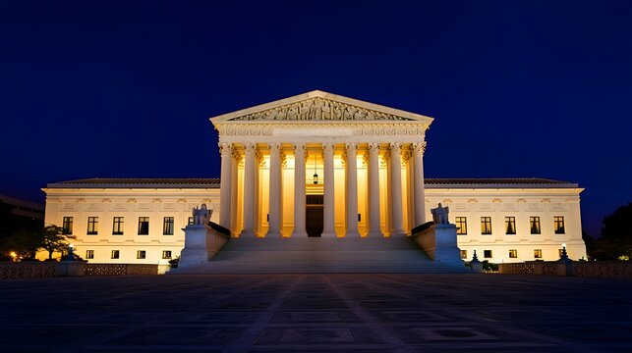
Civic Tech Emergency Briefing
The Voting Rights
Act 2026
A UI/UX Designer's Guide to
Protecting Democracy After
Louisiana v. Callais
April 29, 2026
Prepared For: Civic Tech Designers, Developers & Product Managers

Slide 2
Navigation
The Supreme Court Ruling
01
Contents
Analyzing the 6-3 decision and its devastating shift to intentional discrimination standards
Domino Effects Across the U.S.
02
Immediate, short-term, and long-term consequences for American democracy
The UX Crisis
03
Why digital voter tools fail: accessibility, jargon, and mobile friction
The 5 UI/UX Fixes
04
Actionable design principles to save democratic access
The UI/UX Trust Audit
05
A rigorous 5-day implementation plan for civic tech teams
Six critical sections mapping the legal crisis, its cascading effects, and the actionable UI/UX strategies to defend democratic access in the digital realm.
Final Word
06
The new battleground and the designer's mandate

Slide 3
Section 01
The Supreme Court Ruling
Louisiana v. Callais
The Consequence
6-3 decision striking down Louisiana's congressional map with a second majority-Black district.
Opens the door for states to systematically dilute minority voting power under the guise of partisan gerrymandering.
VOTE BREAKDOWN
States can claim "political" rather than "racial" motivation
6
3
Minority communities lose protected status in redistricting
MAJORITY
DISSENT
Legal challenges become nearly impossible to prove
The Shift
Key Legal Precedent Destroyed
In practice, requires proof of intentional racial discrimination — a "dead letter" according to Justice Kagan's dissent.
Section 2, VRA
New Standard
PREVIOUSLY: Results-based protection
NOW: Intentional discrimination required

Slide 4
Section 02
Domino Effects Across the U.S.
Phase 01
Phase 02
Phase 03
Immediate
Short-Term
Long-Term
A "day of devastation" for democracy, fueling huge public concern and online search traffic.
Unlikely to cause widespread map changes before the November 2026 midterms due to ongoing primaries.
Ignites a national redistricting war for the 2028 elections, with states able to dismantle majority-minority districts.
Spike in searches for "voting rights" and "gerrymandering"
Primary elections already underway in many states
2028 redistricting cycle becomes high-stakes battleground
Civic organizations report surge in volunteer inquiries
Legal challenges require months to litigate
States with histories of discrimination gain new freedom
Social media engagement around voting access explodes
Redistricting processes are slow and bureaucratic
Federal oversight mechanisms effectively neutralized
TIMELINE: Days 1-30 post-ruling
TIMELINE: Months 1-6 post-ruling
TIMELINE: 2027-2028 and beyond
Critical Insight: The 2026 midterms remain the last election cycle with current district maps, making digital voter tool optimization urgently necessary before 2028 redistricting begins.

Slide 5
Section 03
The UX Crisis: Why Digital Voter Tools Fail
Jargon Barrier
Confusing legal terms create a huge barrier for new, anxious, or low-literacy voters.
Accessibility
65%
EXAMPLE: "Provisional Ballot"
Most voters don't understand this means their vote may not count if eligibility can't be verified.
of U.S. voter registration websites had medium or low accessibility in 2024
EXAMPLE: "Affidavit Ballot"
Same concept, different name — state-specific terminology creates additional confusion.
Key Failures
Missing alt text on critical forms
Poor color contrast ratios
Mobile Friction
Keyboard navigation broken
Many sites are not optimized for the primary device used by underserved communities: a smartphone.
Slow
Broken
Loading times > 5s
Forms don't resize
When voter tools are inaccessible, they don't just frustrate users — they actively disenfranchise voters with disabilities.
Complex
Data Cost
Multi-step nightmares
Heavy pages expensive

Slide 6
Section 04
The 5 UI/UX Fixes to Save Democracy
01
Accessibility First
02
Kill the Legal Jargon
Design from the ground up for AA compliance and screen reader forgiveness.
Rewrite all copy in plain English (e.g., "provisional ballot" → "safety net ballot").
WCAG 2.1 AA standard minimum
6th-grade reading level target
Screen reader testing mandatory
Contextual definitions embedded
Keyboard-only navigation support
Visual icons paired with text
03
Micro-Nudges
04
Mobile-First / Offline-First
Replace silent loading screens and errors with reassuring, step-by-step guidance.
Optimize for loading speed and allow offline progress saving.
Progress indicators always visible
Progressive web app architecture
Encouraging microcopy at each step
Local storage for form data
Error messages with next actions
Low-bandwidth mode available
Radical Transparency
05
Show a clear visual map of the entire voter journey at the very start. Users should know exactly what steps are required, how long it takes, and what documents they need before they begin.

Slide 7
Section 05
The UI/UX Trust Audit (5-Day Plan)
Day
Accessibility Audit
Goal
1
Run automated WCAG testing tools (axe, WAVE) and manual screen reader tests. Document every violation with severity ratings and remediation steps.
List of AA compliance fixes
Prioritized by user impact severity
Goal
Day
Legal-Jargon Kill-Off
Human-centered microcopy document
2
Audit all copy for legal terminology. Replace with plain-language alternatives. Test comprehension with users at 6th-grade reading level.
Complete terminology translation guide
Goal
Day
Mobile Stress Test
Prioritized mobile UX improvements
3
Test on 3G connections, low-end Android devices, and with screen readers. Measure load times, form completion rates, and error recovery.
Performance bottlenecks identified
Goal
Day
"What If?" Microcopy Sprint
Master document of user-reassuring nudges
4
Map every possible error state and anxiety point. Write reassuring, actionable microcopy that tells users exactly what to do next.
Error state library with solutions
Goal
Day
Pre-Vote Journey Map
Visual map of trust creation and destruction points
5
Create a visual map of the entire voter journey from awareness to ballot cast. Identify every trust creation and destruction point.
Strategic roadmap for UX improvements

Slide 8

Section 06
Final Word
With Section 2 gutted, the fight for voting rights moves from the legal to the digital.
The New Battleground
The Mandate
The user interfaces of voter registration sites, polling place locators, and civic tools.
Every button you design, every error message you clarify, is an act of democratic preservation.
Go design the bridges that the law is tearing down.
April 29, 2026
Prepared For
The Voting Rights Act 2026
Civic Tech Designers, Developers & Product Managers

